Slide 1
OPTIMIZING RESOURCE ALLOCATION IN MULTI-ACCESS EDGE COMPUTING FOR 5G NETWORKS WITH BLOCKCHAIN-BASED VALIDATION
Team Members:
21i320 Karthik R
21i343 Prithiv Vijai U G
21i344 Pukalvanan L
21i366 Vinu V
Project Guide
Dr. Anitha Kumari K
Associate Professor
Department of Information Technology
PSG College of Technology
Coimbatore.

Slide 2
Introduction
With the rise of 5G networks, the demand for ultra-low latency and high-speed connectivity has grown exponentially. Multi-Access Edge Computing (MEC) has emerged as a transformative solution by bringing data processing closer to users, enabling faster and more efficient performance. MEC supports various 5G applications, including enhanced Mobile Broadband (eMBB), Ultra-Reliable Low-Latency Communication (URLLC), and Massive Machine-type Communication (mMTC), making it a cornerstone for next-generation technologies like IoT, smart cities, and autonomous systems.

Slide 3
Problem Statement
The increasing complexity and demand for high-performance applications in modern 5G networks necessitate efficient and secure resource optimization strategies. Multi-Access Edge Computing (MEC) offers low-latency, high-bandwidth, and reliable services at the network's edge. However, achieving dynamic resource allocation to meet diverse application requirements remains a significant challenge. Current approaches often lack modularity, and robust security, which are essential for applications such as enhanced Mobile Broadband (eMBB), Ultra-Reliable Low-Latency Communication (URLLC), and massive Machine-Type Communication (mMTC). Additionally, ensuring the integrity, confidentiality, and reliability of resource allocation processes underscores the growing importance of innovative solutions, such as blockchain, to effectively address these challenges.

Slide 4
Literature Survey :
S.No | Title and Authors of the paper | Publication Year and Conference | Inferences | Drawbacks
1. | Blockchain-Enabled Federated Learning-Based Resource Allocation and Trading for Network Slicing in 5G by D. Ayepah-Mensah, G. Sun, G. O. Boateng, et al. | 2024, IEEE/ACM Transactions on Networking | Federated learning and blockchain improve resource allocation efficiency and transparency in network slicing. | Limited scalability and higher computational overhead.
2. | DBNS: A Distributed Blockchain-Enabled Network Slicing Framework for 5G Networks by M. A. Togou et al. | 2020, IEEE Communications Magazine | Proposes a secure, distributed network slicing framework for 5G networks. | Complexity in managing distributed ledgers.

Slide 5
Cont’d
3. | SliceBlock: Context-Aware Authentication Handover and Secure Network Slicing Using DAG-Blockchain in Edge-Assisted SDN/NFV-6G Environment by I. H. Abdulqadder and S. Zhou. | 2022, IEEE Internet of Things Journal. | Context-aware blockchain supports secure handovers and efficient slicing in edge-assisted networks. | Results in higher latency during context verification.
4. | Consortium Blockchain Based Spectrum Trading for Network Slicing in 5G RAN: A Multi-Agent Deep Reinforcement Learning Approach by G. O. Boateng, G. Sun, D. A. Mensah, D. M. Doe, R. Ou, and G. Liu. | 2023, IEEE Transactions on Mobile Computing. | The framework uses consortium blockchain for secure, transparent spectrum trading, ensuring trust without central authority. | Integrating blockchain with 5G infrastructure demands careful compatibility and interoperability, complicating deployment.

Slide 6
Cont’d
5. | MEC Support for 5G-V2X Use Cases through Docker Containers by C. Campolo, A. Iera, A. Molinaro, and G. Ruggeri. | 2019, IEEE Wireless Communications and Networking Conference. | Utilizes MEC and Docker containers to improve 5G-V2X application support. | Limited adaptability to dynamic vehicular scenarios.
6. | Blockchain-Based Computing Resource Trading in Autonomous Multi-Access Edge Network Slicing: A Dueling Double Deep Q-Learning Approach by T. Kwantwi, G. Sun, N. A. E. Kuadey, G. T. Maale, and G. Liu. | 2023, IEEE Transactions on Network and Service Management. | Utilizes blockchain for secure, transparent, and decentralized resource trading, preventing data tampering and fraud while offering a verifiable record of resource allocation. | Performance degrades under high network traffic.

Slide 7
Cont’d
7. | Deep Reinforcement Learning for Edge Computing Resource Allocation in Blockchain Network Slicing Broker Framework by Y. Gong, S. Sun, Y. Wei, and M. Song. | 2021, IEEE Vehicular Technology Conference. | Introduces a reinforcement learning framework for resource allocation in blockchain-based slicing. | Requires significant computational power for real-time applications.
8. | IIoT-MEC: A Novel Mobile Edge Computing Framework for 5G-enabled IIoT by X. Hou, Z. Ren, K. Yang, C. Chen, H. Zhang, and Y. Xiao. | 2019, IEEE Wireless Communications and Networking Conference. | Proposes a MEC framework for 5G-enabled Industrial IoT. | Lacks scalability for larger industrial networks.

Slide 8
Drawbacks of existing system:
Inefficient Resource Allocation: Unable to dynamically adjust for varying latency and bandwidth, causing wastage.
Security Issues: Lack of security in decentralized resource management, increasing vulnerability to attacks.
Lack of Transparency: No clear tracking of resource allocation, affecting trust and service efficiency.
Limited Automation: Requires manual intervention for resource management, leading to delays and errors.

Slide 9
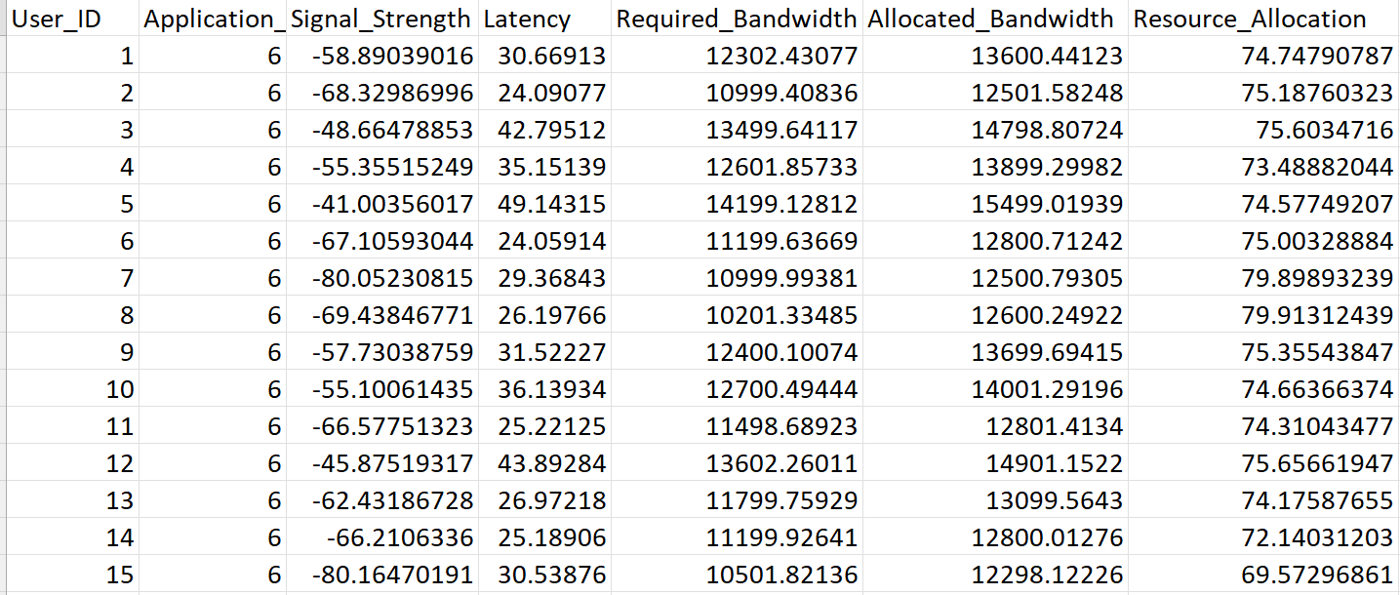
Dataset used :
5G user allocation dataset :
7 features and 16000 rows
Dataset link - https://www.kaggle.com/datasets/vinu1233/augmented-5g-dataset-for-resource-allocation

Slide 10
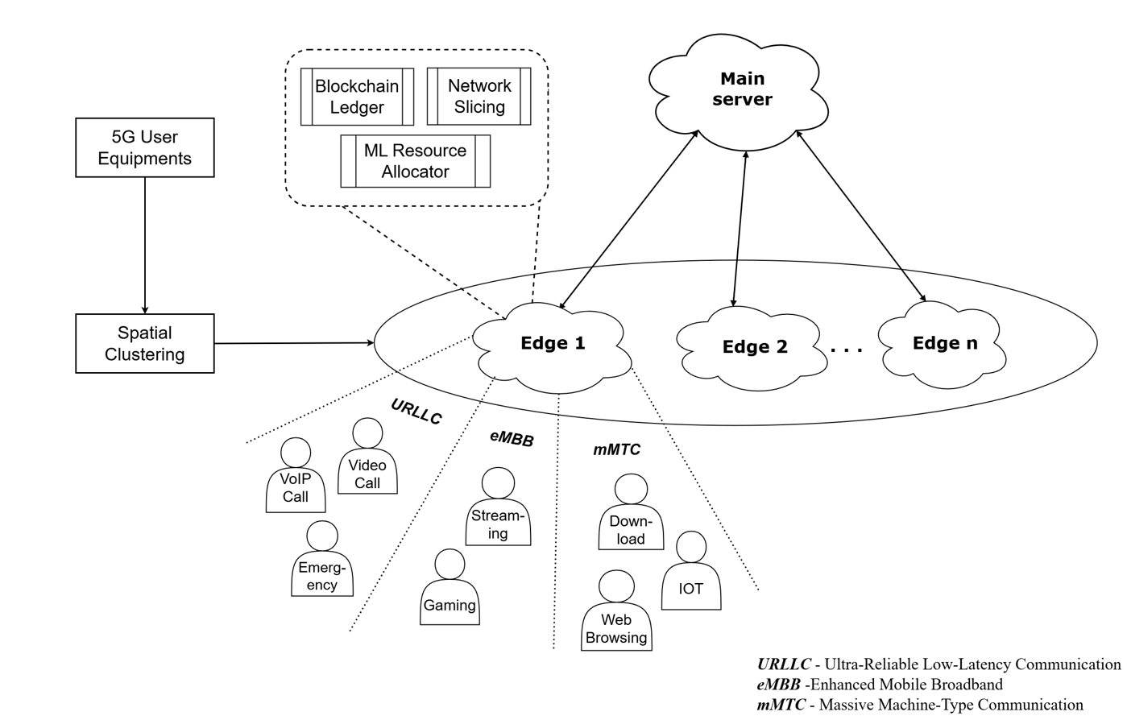
Proposed methodology – Block diagram :

Slide 11
Module 1: Clustering Users for MEC
Objective:
Cluster users based on proximity for efficient MEC resource allocation.
Key Features:
Simulate 5G environments to capture proxies based on latency and signal strength.
Apply clustering using proximity parameters.
Implementation:
Simulate (distance , coordinates) using NS-3.
Cluster users with algorithms like k-means or DBSCAN and save results for further use.

Slide 12
Module 2: MEC Setup
Objective:
Design and implement a Multi-Access Edge Computing (MEC) framework for efficient resource allocation using the pretrained LightGBM model .
Key Features:
Simulate Realtime MEC network
Integrate network slicing and resource allocation prediction.
Implementation:
Set up Docker containers for each edge node listening at individual ports.

Slide 13
Module 3: Blockchain Integration
Objective: To Implement blockchain to enhance transparency, decentralization, and security in MEC resource optimization .
Key Features:
Decentralized resource management of user logs data with blockchain.
Implementation:
Set up a blockchain framework using ethereum and deploy smart contracts.
Integrate blockchain with MEC.

Slide 14
Implementation :
Distance simulation using NS3:
The distance for each user is calculated based on Signal Strength and Latency using NS-3's inbuilt propagation models.
The Friis Propagation Loss Model from NS-3 is used to estimate the distance based on the signal strength.
Latency is used to calculate distance by assuming signal propagation at the speed of light.
This process ensures that both signal quality (via strength) and network performance (via latency) are considered to calculate the most accurate distance estimate and then a random angle is introduced to acquire the x,y coordinates for each user.

Slide 15
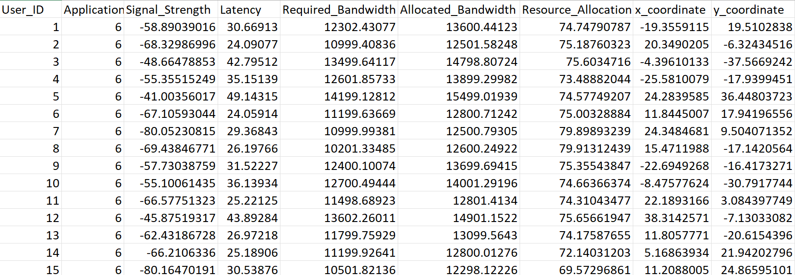
Implementation :
Simulated dataset :

Slide 16
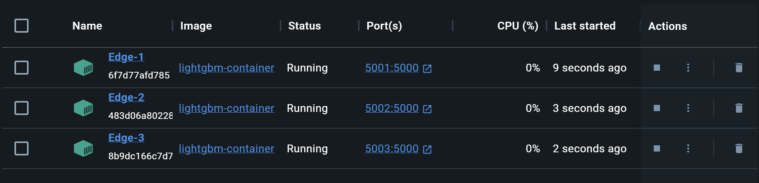
Implementation :
MEC Setup using docker :
The Edge nodes in MEC network are represented by individual docker containers operating in different ports with the pretrained lightgbm model loaded.

Slide 17
Implementation :
MEC Visualization :

Slide 18
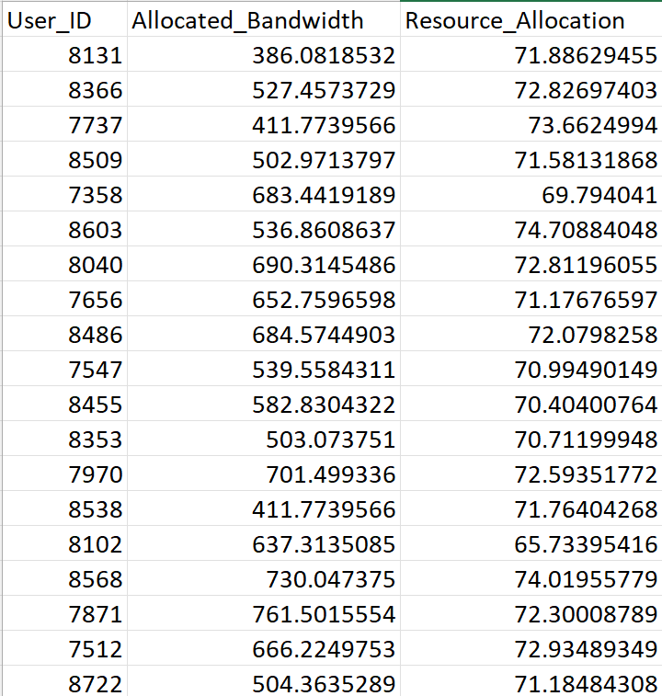
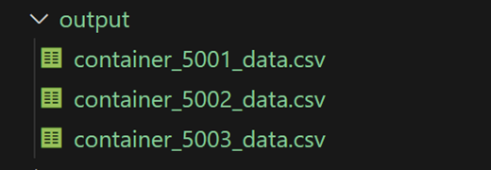
Implementation :
Edge data :
Output data : Received by the central node (server) from each of the edge nodes.

Slide 19
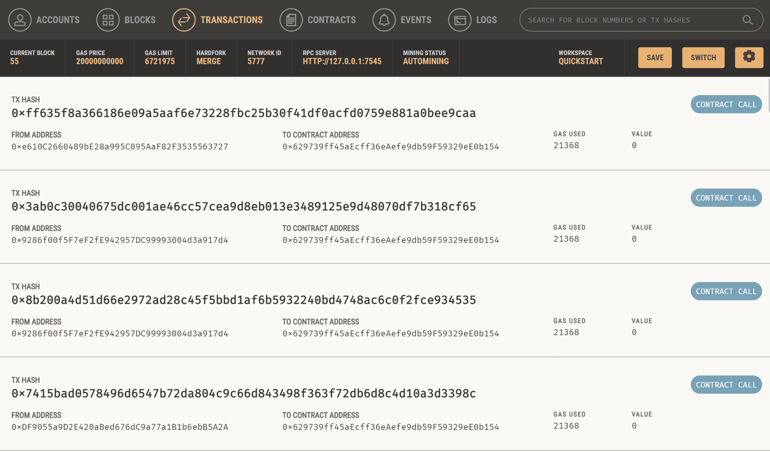
Implementation :
Blockchain
Transactions
in ganache →
Address of respective edge node

Slide 20
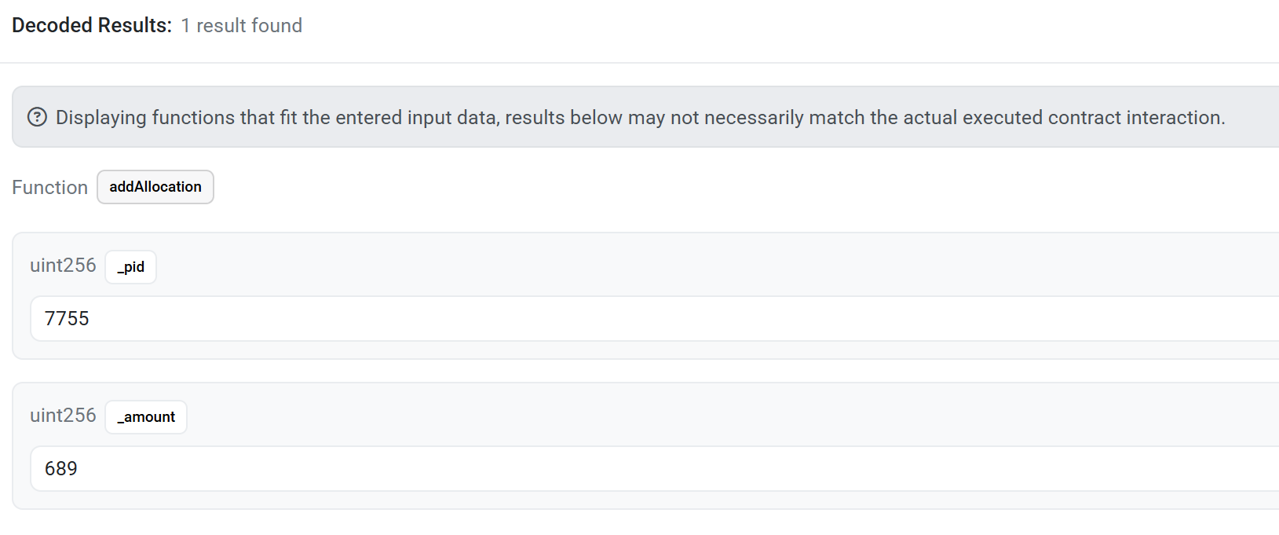
Implementation :
Stored log data in blockchain :
User_ID
Allocated_Bandwidth

Slide 21
Pending works:
Implement network slicing.
Increase the number of edges and compare.
Analyse blockchain gas usage.
Result analysis.

Slide 22
Individual Contributions:
Prithiv vijai UG - Simulated the dataset using NS3 to acquire coordinates.
Pukalvanan L - Implemented the clustering and MEC setup using Docker.
Karthik R - Integrated blockchain and added smart contracts for user logs.
Vinu V - Increased the number of edges and decentralized blockchain to respective edges.

Slide 23
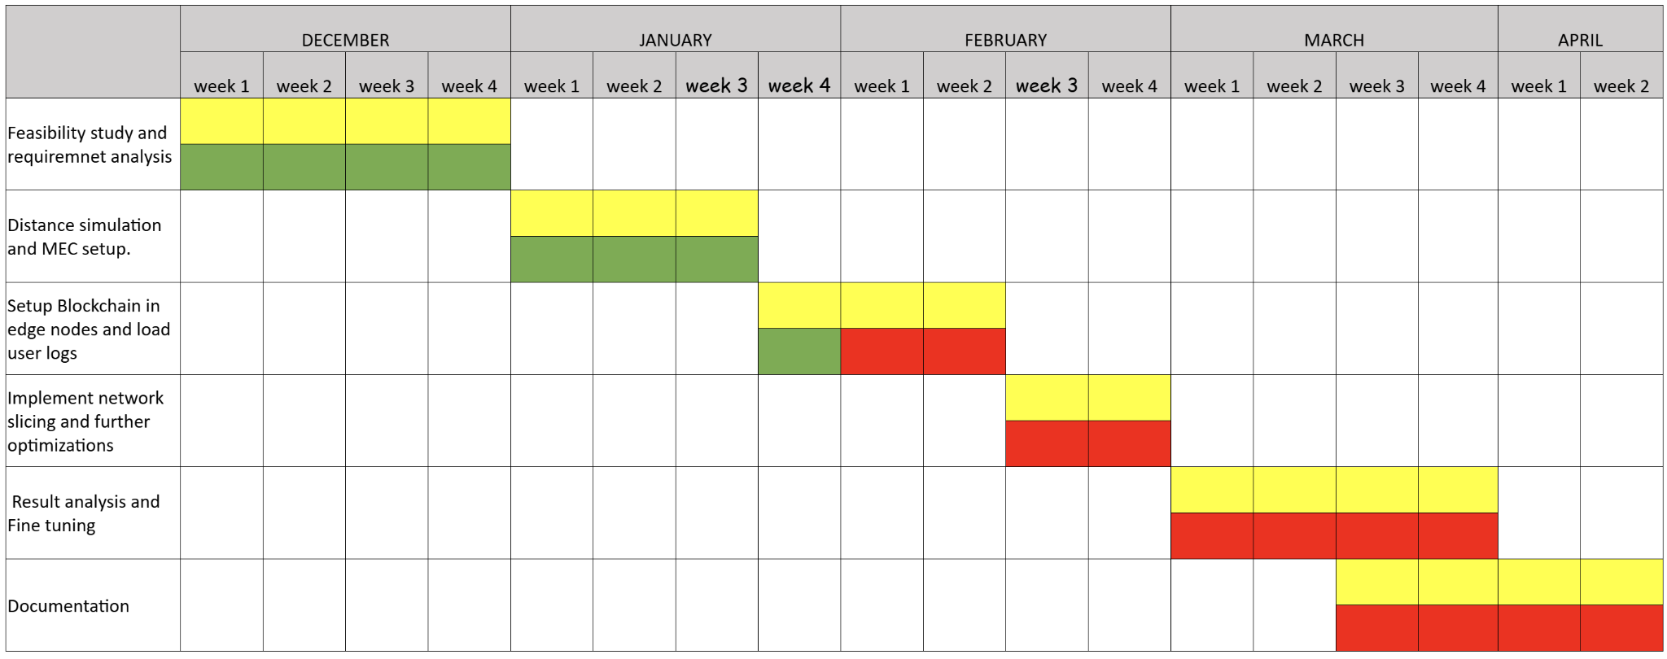
Timeline chart: -
Work in progress
Works Assigned
Works to be done

Slide 24
References: -
D. Ayepah-Mensah, G. Sun, G. O. Boateng, S. Anokye and G. Liu, "Blockchain-Enabled Federated Learning-Based Resource Allocation and Trading for Network Slicing in 5G," in IEEE/ACM Transactions on Networking, vol. 32, no. 1, pp. 654-669, Feb. 2024, doi: 10.1109/TNET.2023.3297390.
M. A. Togou et al., "DBNS: A Distributed Blockchain-Enabled Network Slicing Framework for 5G Networks," in IEEE Communications Magazine, vol. 58, no. 11, pp. 90-96, November 2020, doi: 10.1109/MCOM.001.2000112.
I.H. Abdulqadder and S. Zhou, "SliceBlock: Context-Aware Authentication Handover and Secure Network Slicing Using DAG-Blockchain in Edge-Assisted SDN/NFV-6G Environment," in IEEE Internet of Things Journal, vol. 9, no. 18, pp. 18079-18097, 15 Sept.15, 2022, doi: 10.1109/JIOT.2022.3161838.
G. O. Boateng, G. Sun, D. A. Mensah, D. M. Doe, R. Ou and G. Liu, "Consortium Blockchain-Based Spectrum Trading for Network Slicing in 5G RAN: A Multi-Agent Deep Reinforcement Learning Approach," in IEEE Transactions on Mobile Computing, vol. 22, no. 10, pp. 5801-5815, 1 Oct. 2023, doi: 10.1109/TMC.2022.3190449.
C. Campolo, A. Iera, A. Molinaro and G. Ruggeri, "MEC Support for 5G-V2X Use Cases through Docker Containers," 2019 IEEE Wireless Communications and Networking Conference (WCNC), Marrakesh, Morocco, 2019, pp. 1-6, doi: 10.1109/WCNC.2019.8885515.

Slide 25
References: -
T. Kwantwi, G. Sun, N. A. E. Kuadey, G. T. Maale and G. Liu, "Blockchain-Based Computing Resource Trading in Autonomous Multi-Access Edge Network Slicing: A Dueling Double Deep Q-Learning Approach," in IEEE Transactions on Network and Service Management, vol. 20, no. 3, pp. 2912-2928, Sept. 2023, doi: 10.1109/TNSM.2023.3240301.
Y. Gong, S. Sun, Y. Wei and M. Song, "Deep Reinforcement Learning for Edge Computing Resource Allocation in Blockchain Network Slicing Broker Framework," 2021 IEEE 93rd Vehicular Technology Conference (VTC2021-Spring), Helsinki, Finland, 2021, pp. 1-6, doi: 10.1109/VTC2021-Spring51267.2021.9449081.
X. Hou, Z. Ren, K. Yang, C. Chen, H. Zhang and Y. Xiao, "IIoT-MEC: A Novel Mobile Edge Computing Framework for 5G-enabled IIoT," 2019 IEEE Wireless Communications and Networking Conference (WCNC), Marrakesh, Morocco, 2019, pp. 1-7, doi: 10.1109/WCNC.2019.8885703.

Slide 26
THANK YOU!

